Slide 1
Best Practices with Fabric CI-CD Diagrams, Images and Screenshots

Slide 2
Developer 1
merge changes
shared
codebase
Developer 2
merge changes
Developer N
merge changes

Slide 3
dev
test
prod

Slide 4
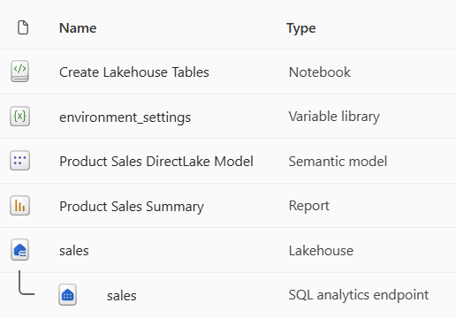
solution workspace

Slide 5
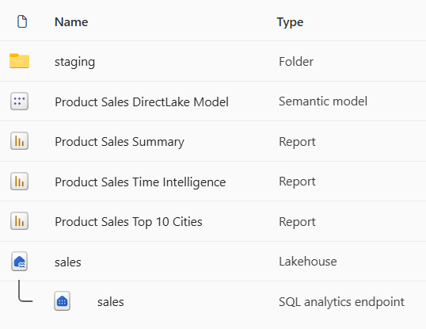
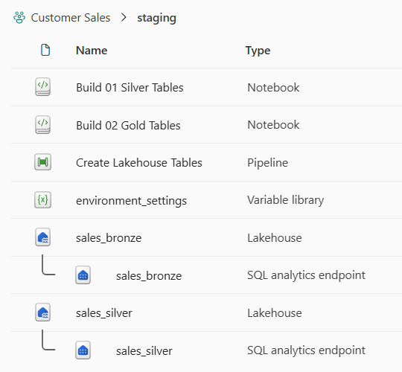
presentation workspace
staging workspace

Slide 6
dev environment
test environment
prod environment

Slide 7
dev environment
test environment
prod environment
Fabric Workspace
Fabric Workspace
Fabric Workspace
Fabric capacity (F4)
Fabric capacity (F16)
Fabric capacity (F64)

Slide 8
dev environment
test environment
prod environment
Fabric Workspace
Fabric Workspace
Fabric Workspace
Fabric capacity (F4)
Fabric capacity (F16)
Fabric capacity (F64)
Azure Storage Account
used to store dev data files
Azure Storage Account
used to store test data files
Azure Storage Account
used to store prod data files
Fabric Connection
to dev storage account
Fabric Connection
to test storage account
Fabric Connection
to prod storage account

Slide 9
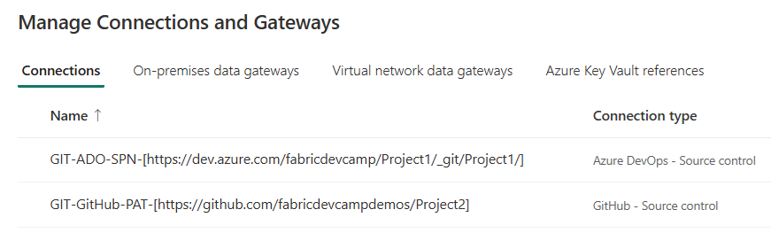

Slide 10
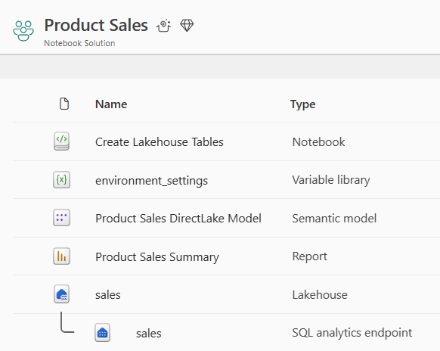
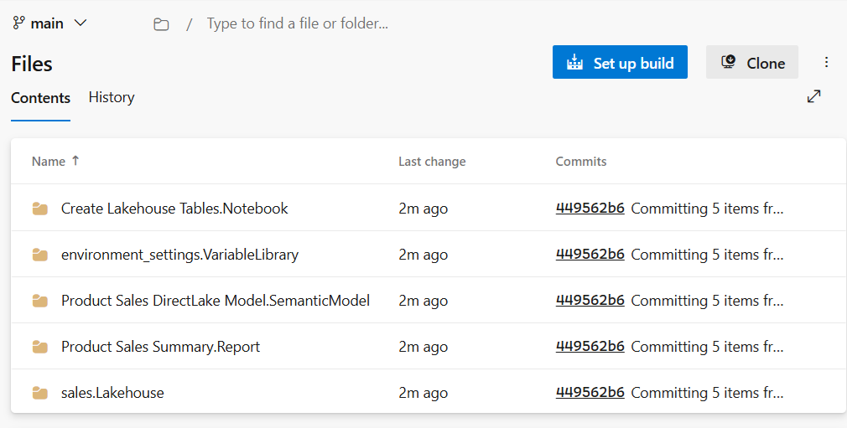
Commit to GIT

Slide 11
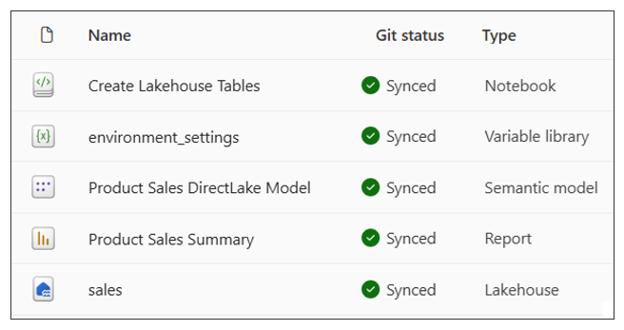

Slide 12
workspace
Update from GIT
GIT
branch

Slide 13
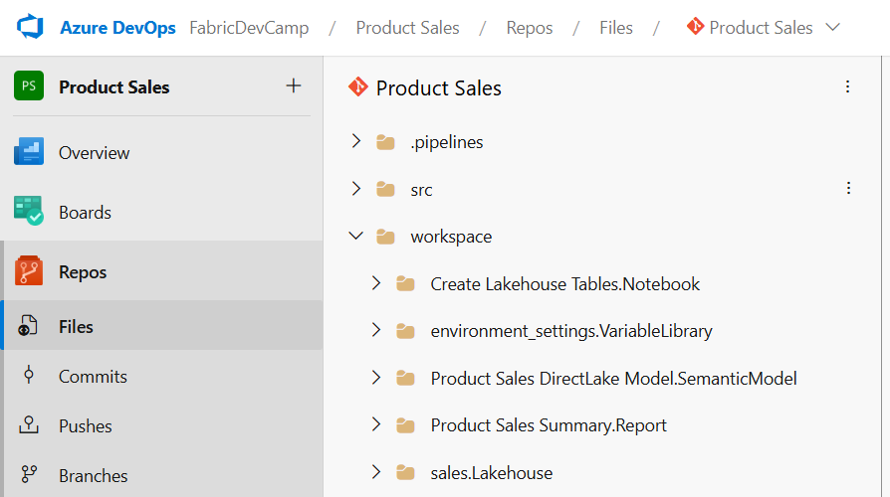

Slide 14
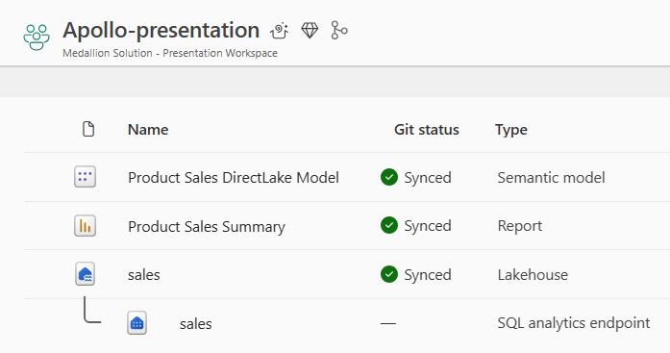
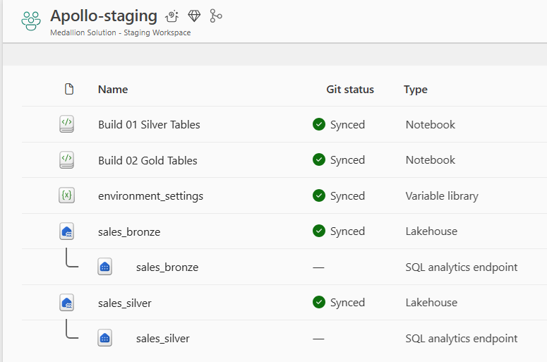
Fabric solution design with Medallion architecture

Slide 15
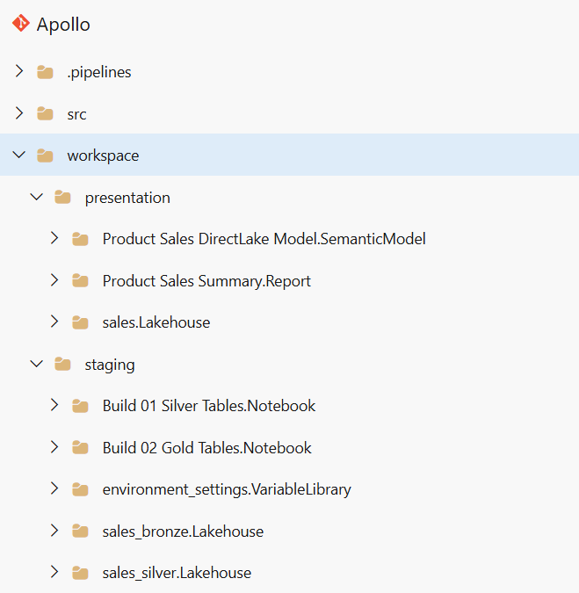

Slide 16
feature
branch
Pull Request
integration
branch

Slide 17
dev
workspace
Commit to GIT
integration
branch

Slide 18
integration
branch
feature
branch
Update from GIT
feature
workspace
Create Branch

Slide 19
feature_1
workspace
Commit to GIT
feature_1
branch
Pull Request
integration
branch
feature_2
workspace
Commit to GIT
feature_2
branch
Pull Request
feature_N
workspace
Commit to GIT
feature_N
branch
Pull Request

Slide 20
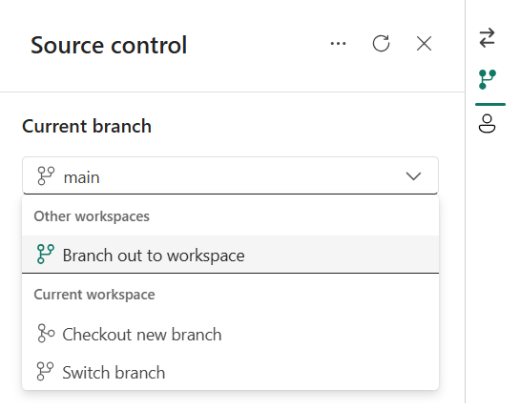

Slide 21
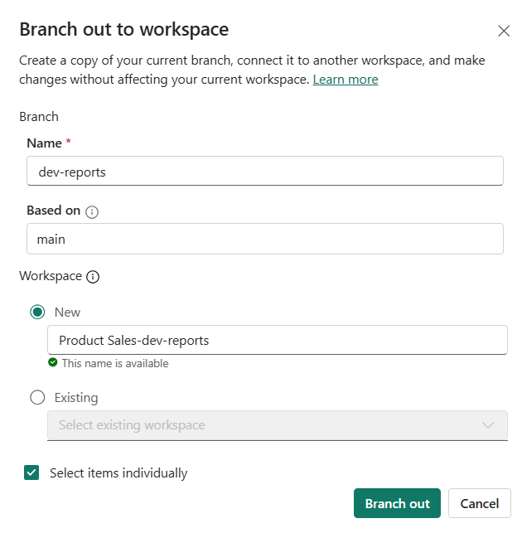

Slide 22
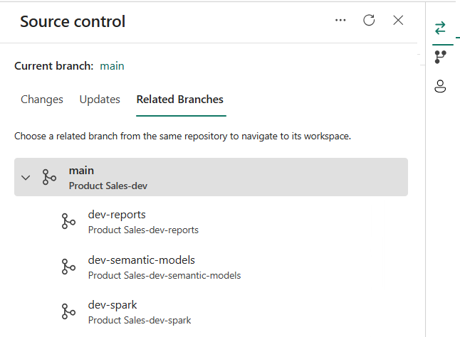
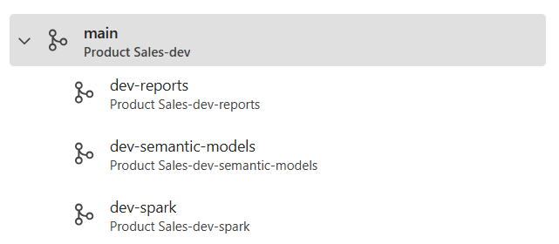

Slide 24
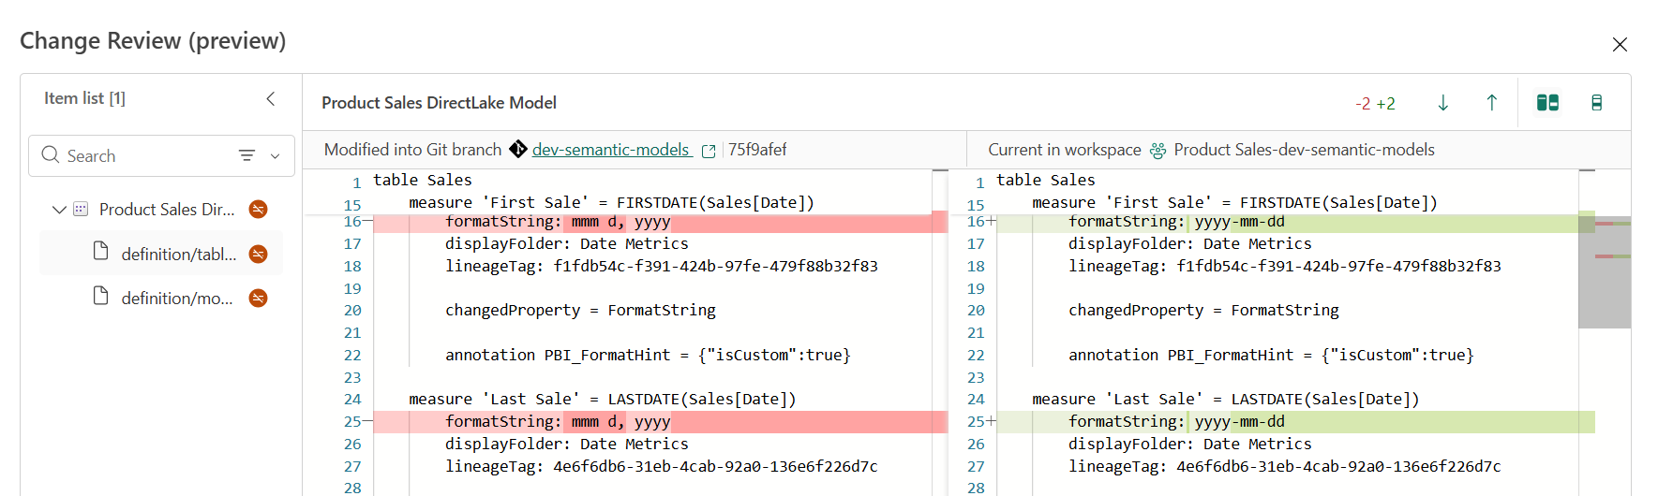

Slide 25
Origin GIT Repository
Developer Desktop
integration
branch
feature
branch
local folder
Create Branch
git clone

Slide 26
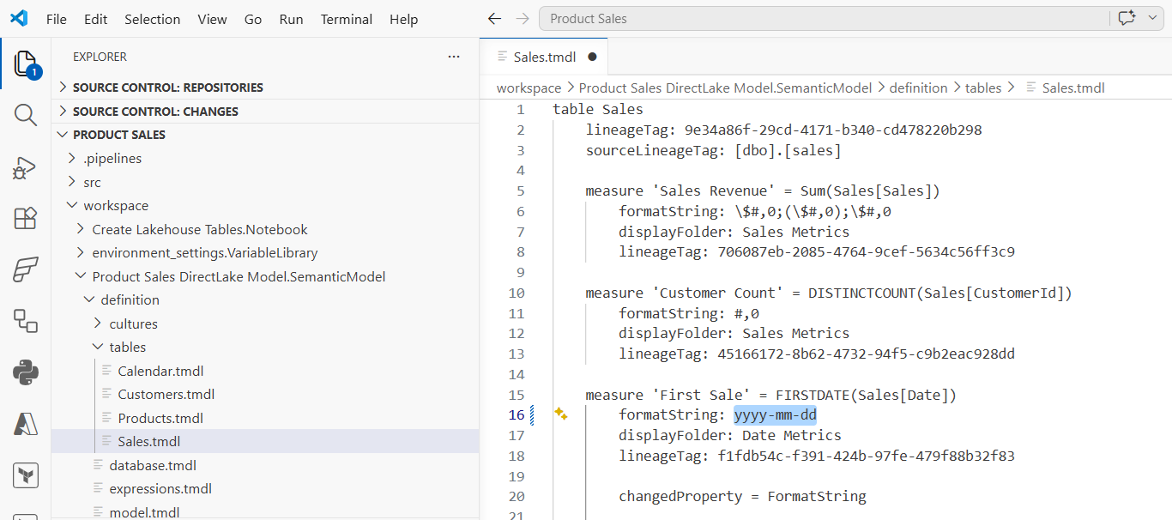

Slide 27
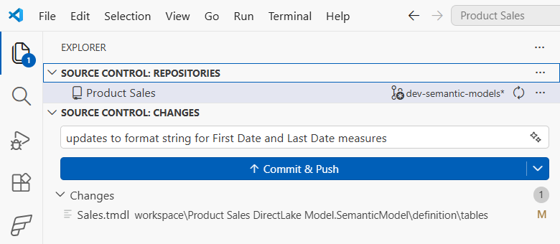

Slide 28
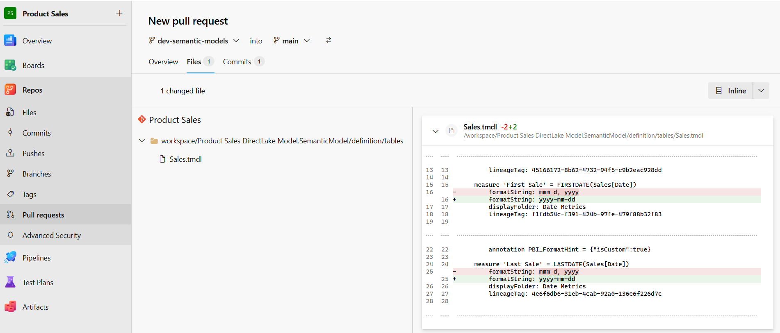

Slide 29

Visual Studio Code
branched
workspace
manual
edits
Update
from GIT
local
files
feature
branch
integration
branch
git push
Pull Request

Slide 30
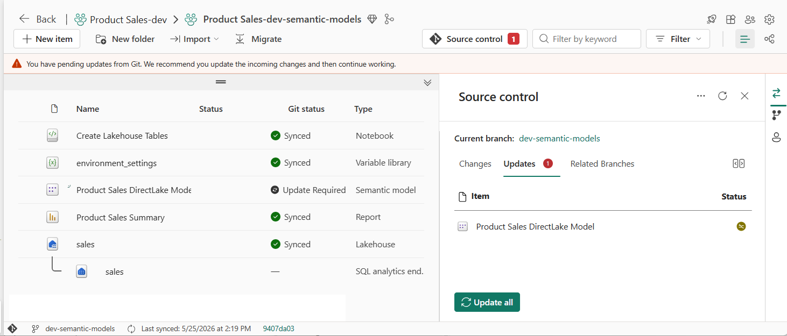

Slide 31
workspace
Notebook
Pipeline
Variable Library
Copyjob
var1 - string - 'foo'
var2 - string - 'bar'
var3 - integer - 42
Dataflow
Lakehouse Shortcut

Slide 32
dev
workspace
test
workspace
prod
workspace

Slide 33
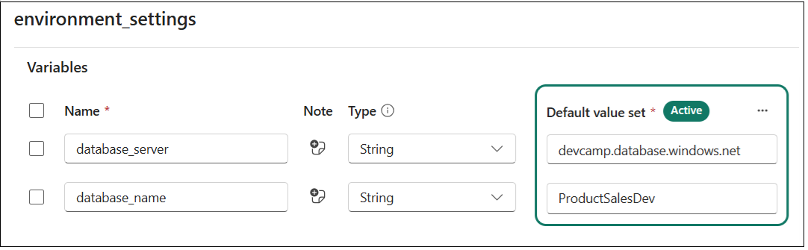

Slide 34
Variable Name | Type | Default Value
database_server | String | devcamp.database.windows.net
database_name | String | product-sales-dev

Slide 35
Variable Library
Value Sets
Variable Name | Type | Default Value
database_server | String | dev value
database_name | String | dev value
test
test value
test value
prod
prod value
prod value

Slide 36
dev workspace
test workspace
prod workspace
Variable Library
Variable Library
Variable Library
default value set (active)
test value set
prod value set
default value set
test value set (active)
prod value set
default value set
test value set
prod value set (active)

Slide 37





Fabric Solution
Variable Library
Lakehouse
Notebook
Semantic Model
Report

Slide 38

dev workspace
Notebook
Lakehouse
Pipeline

Slide 39
dev workspace
feature workspace
Notebook
Notebook
Lakehouse
Pipeline
Lakehouse
Pipeline
Commit
to GIT
Update
from GIT
integration
branch
Create Branch
feature
branch

Slide 40
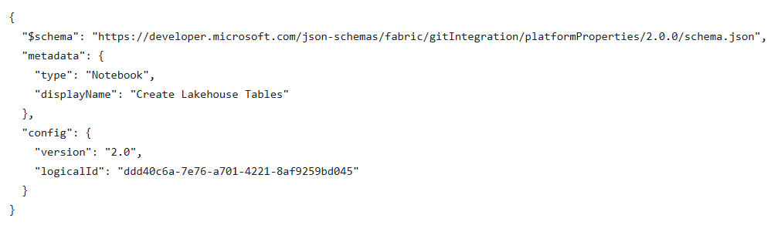

Slide 41
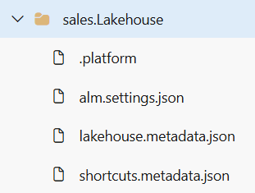

Slide 42
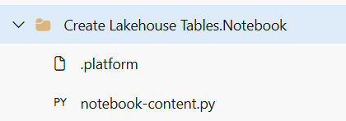
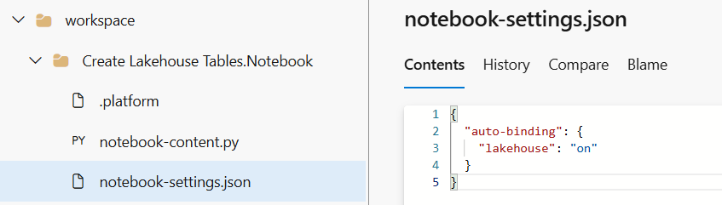

Slide 43
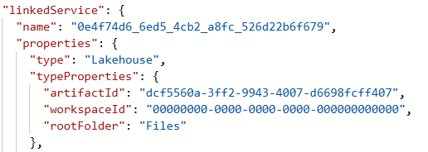

Slide 44
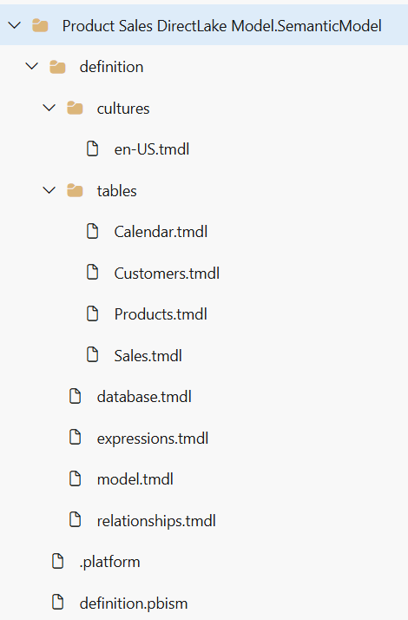

Slide 45
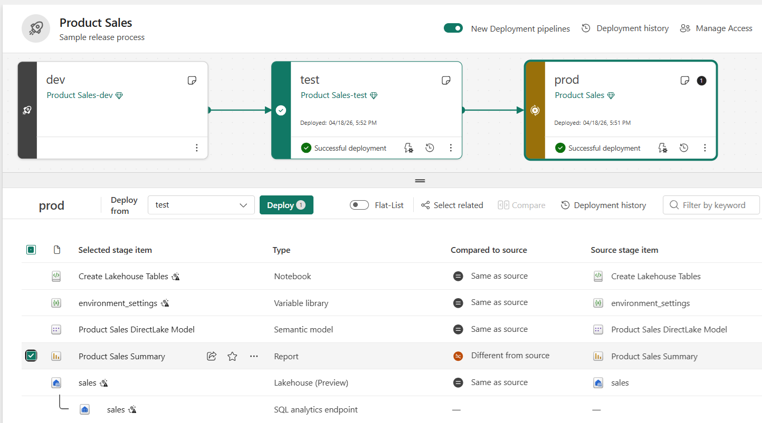

Slide 46
Terraform
Fabric CLI
Semantic Link Labs
fabric-cicd
.NET SDK
Python SDK
Fabric REST APIs

Slide 47
integration
branch
feature
branch
Update from GIT
feature
workspace
Create Branch

Slide 48
z
feature
workspace
Commit to GIT
feature
branch
Pull Request
integration
branch
z
integration
branch
custom workflow
dev
workspace
Update from GIT
Run post-sync job

Slide 49
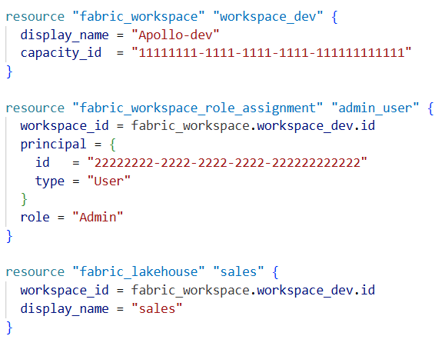
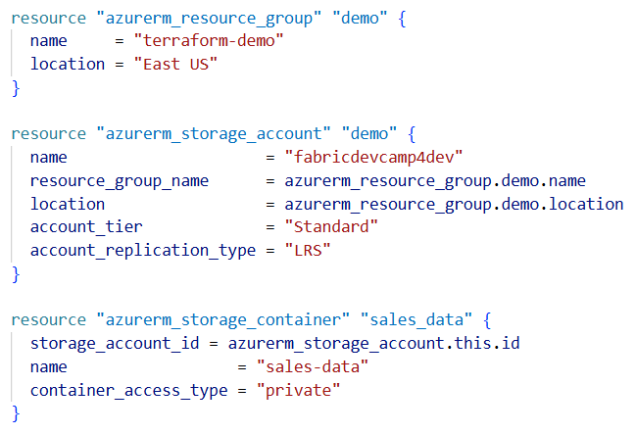
Your Terraform Configuration
Terraform
Terraform provider for Fabric (fabric)
Terraform provider for Azure (azurerm)
Fabric REST APIs
Azure REST APIs

Slide 50
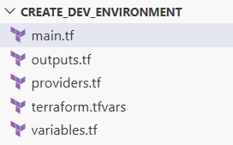

Slide 51
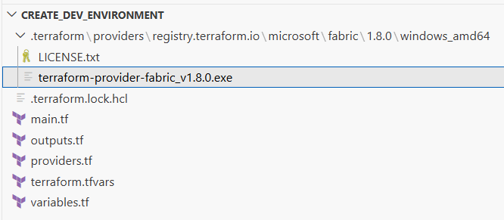

Slide 52
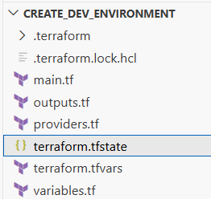
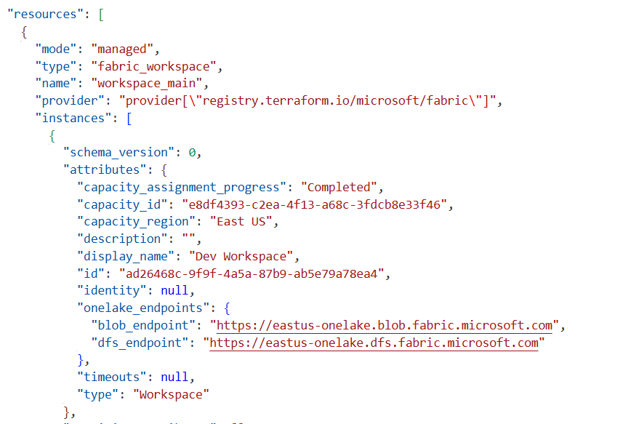

Slide 53
dev environment
test environment
prod environment
Fabric Workspace
Fabric Workspace
Fabric Workspace
Fabric capacity (F4)
Fabric capacity (F16)
Fabric capacity (F64)
Azure Storage Account
used to store dev data files
Azure Storage Account
used to store test data files
Azure Storage Account
used to store prod data files
Fabric Connection
to dev storage account
Fabric Connection
to test storage account
Fabric Connection
to prod storage account

Slide 54
Development Process (CI)
Release Process (CD)
Dev
workspace
Test
workspace
?
feature
workspace
feature
branch
integration
branch
Prod
workspace
feature
workspace
feature
branch

Slide 55
Fabric Deployment Pipeline
dev
workspace
Deploy
test
workspace
Deploy
prod
workspace
GIT
sync
main
branch

Slide 56
dev
workspace
test
workspace
prod
workspace
Update
from GIT
Update
from GIT
Update
from GIT
dev
branch
Pull Request
test
branch
Pull Request
main
branch

Slide 57
z
release
branch
release process
prod
workspace
Call Update from GIT
Run post-sync job

Slide 58
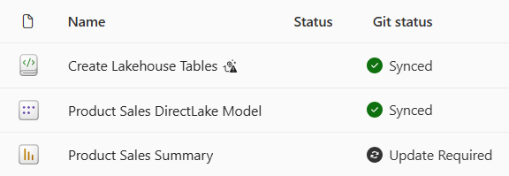

Slide 59
dev
workspace
test
workspace
prod
workspace
Update
from GIT
fabric-cicd
fabric-cicd
dev
branch
Pull Request
test
branch
Pull Request
main
branch

Slide 60
dev
workspace
Update
from GIT
main
branch
test
workspace
fabric-cicd
fabric-cicd
prod
workspace

Slide 61
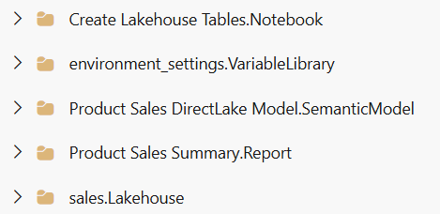
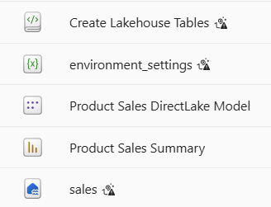
Folder with Item Definitions
fabric-cicd processing
target workspace
Create or Update Item
Create or Update Item
Create or Update Item
Create or Update Item
Create or Update Item

Slide 62
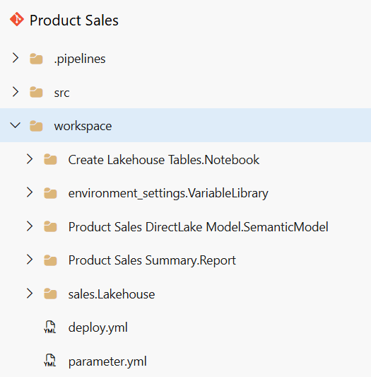

Slide 63
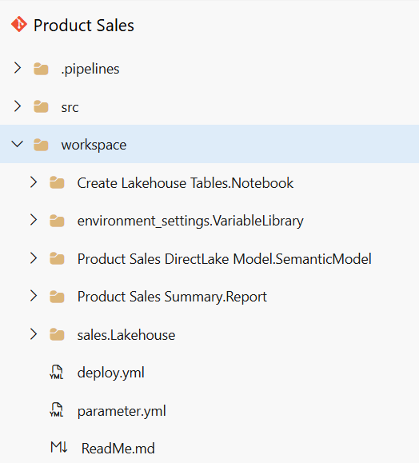

Slide 64
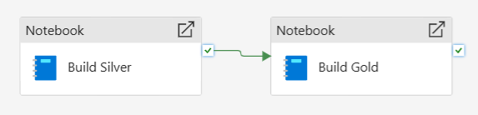
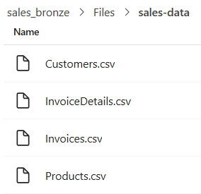
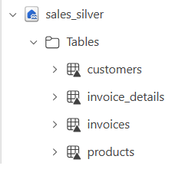
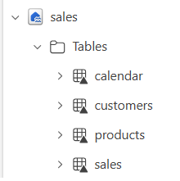


Fabric Solution Workspace
Create Lakehouse Tables
Azure Storage
Account
Bronze Lakehouse
Silver Lakehouse
Gold Lakehouse
ADLS Gen2
Shortcut
Build
Silver
Build
Gols

Slide 65
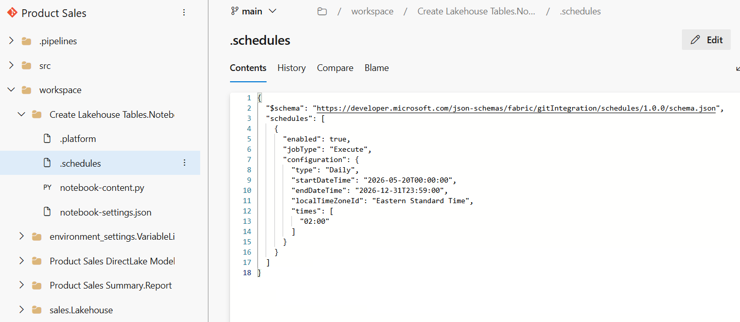

Slide 66
Your Code
Item
Definition
Fabric
REST
APIs
Create Item
Item
Definition
Update Item Definition
Item
Definition
Get Item Definition

Slide 67
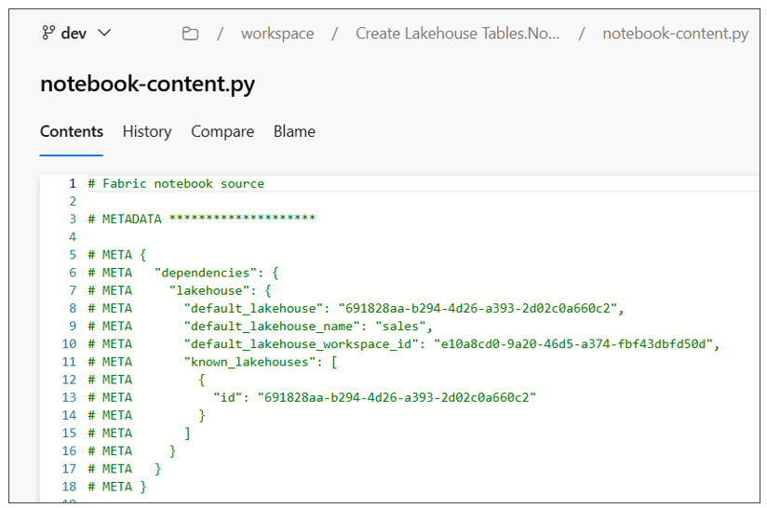

Slide 68
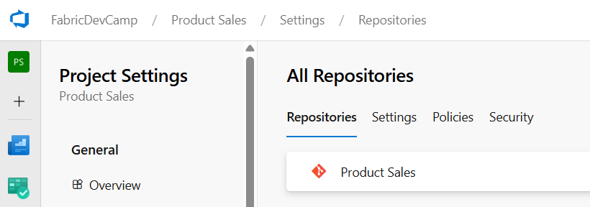

Slide 69
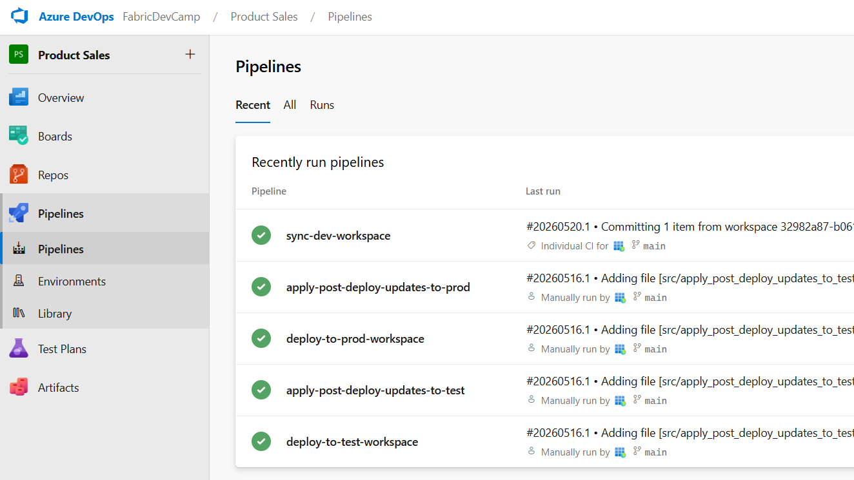

Slide 70
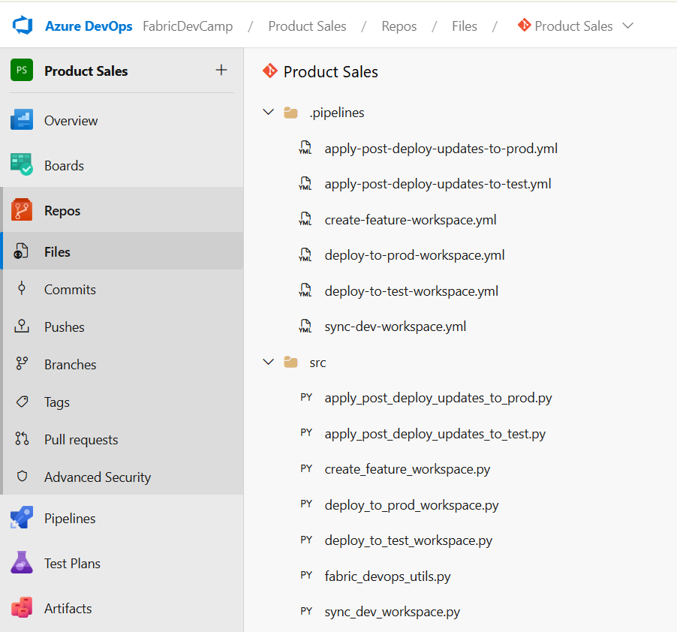

Slide 71
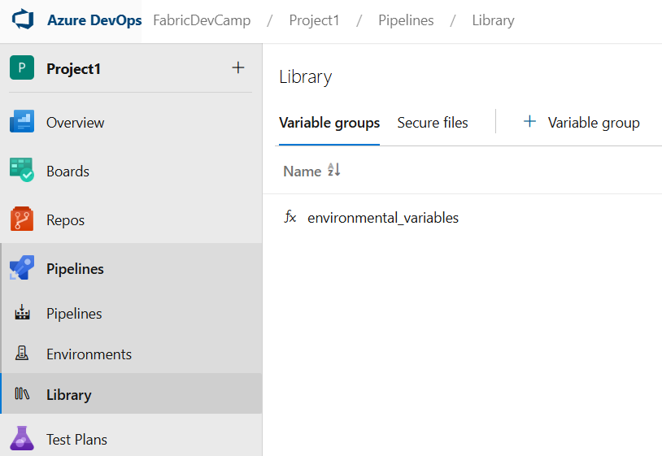
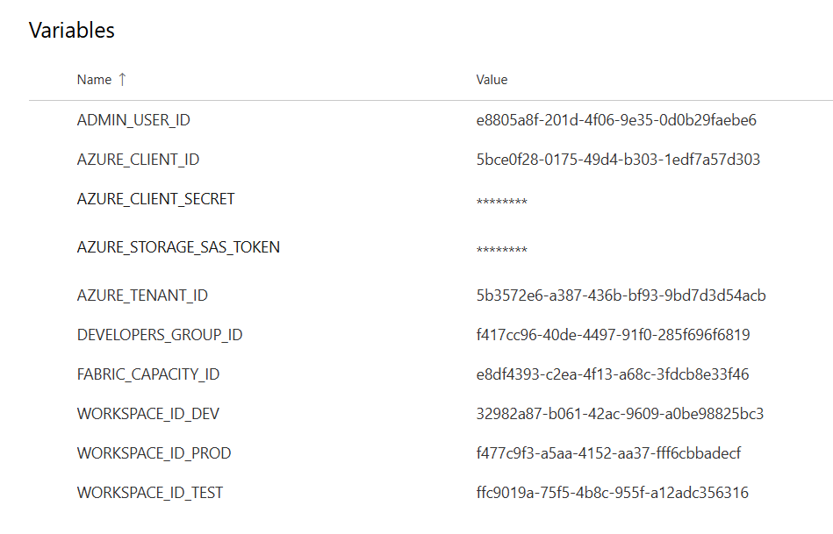

Slide 72


Slide 73


Slide 74


Slide 75


Slide 76


Slide 77


Slide 78


Slide 79


Slide 80


Slide 81


Slide 82


Slide 83


